Slide 1

Group 14
Level 4/5 Group 14: Ethan Ward, Mircea Lazar, Petrut Vasile, Toby White

Slide 2
How the game fits the brief
E
2D
Controlled by simple tap
Each player has a turn within one round
Played on a mobile phone
Symmetrical
Simple and intuitive to play
Notes:
The Assignment
2D Game
Main control mechanic is a simple tap
Multiplayer – by taking turns
On a single device
Symmetric
Simple and intuitive rules
The gameplay experience should be
Engaging
Focused
Polished
Why mobile?
Growing at a phenomenal pace
Why tap?
Casual Users don’t have years of gaming experience
Casual Users don’t have the dexterity of gamers
Casual Users play on their phone to pass time
So everyone can play the game
Supports all kinds of users
Easy to control and understand but difficult to master!
Why multiplayer?
The competitive nature of the game makes it easy for users to commit to it giving your game a higher retention than single player games.
It creates a feeling of urgency as both players progress through gameplay and approach the “finish line”.
Opponents are also a strong tool in making an experience that is always fresh.

Slide 3

Target audience
T
Core audience
Ages between 11-25
Male
casual gamers

Slide 4
What are the games challenges?
M

Slide 5
The player experience
M
We want both of the players to experience a sense of hard fun
Fiero, strategy and obstacles
A sense of people fun
Amusement and player interaction

Slide 6
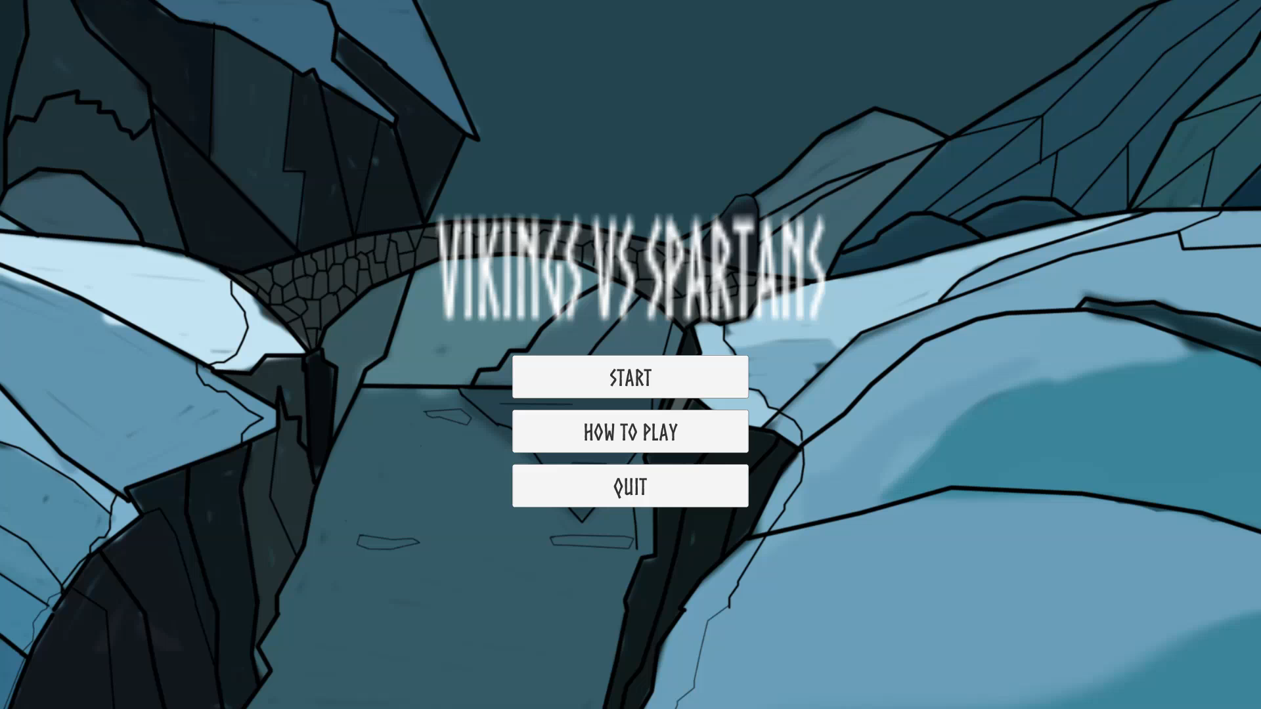
What does the player do (Prototype)?
E

Slide 7
Mechanics:
P

Slide 8
Concept Art
M&T

Slide 9
The following week
E
Improve the prototype based on player feedback
Refine game mechanics
Finalize the art
Notes:
Improve the prototype based on player feedback
Finish the art for the game

Slide 10
Any Questions?

